Slide 1

Write the superlative forms of adjectives and adverbs.
形容词/副词 | 最高级
big
popular
short
food/well
expensive
boring
quickly
interesting
形容词/副词 | 最高级
comfortable
comfortably
close
bad/badly
cheap
cheaply
carefully
fresh
biggest
most comfortable
most popular
most comfortably
shortest
closest
best
worst
most expensive
cheapest
most boring
most cheaply
most quickly
most carefully
most interesting
freshest

Slide 2

Exercise
舒适的座位
大屏幕
离家近
最短的等待时间
在城里
欢迎来到……
到目前为止；迄今为止
comfortable seats
big screens
be close to home
the shortest waiting time
in town
welcome to ...
so far

Slide 3
Exercise
舒适的座位
大屏幕
离家近
最好的声效
快速购票
comfortable seats
big screens
be close to home
the best sound
buy tickets quickly

Slide 4

Unit 4

Slide 5
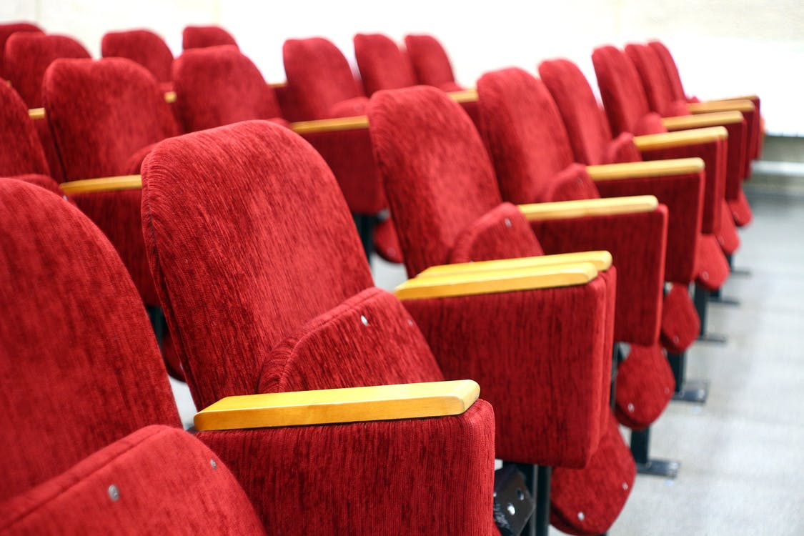
Unit 4
What's the best movie theater?

Slide 6
Presentation
形容词和副词最高级的规则变化规律 P114
 | 规则变化规律
单音节词/ 双音节词
多音节词/双音节词
一般在词尾+est
以e结尾的词+st
重读闭音节词词尾只有一个辅音字母，双写辅音字母+est
辅音字母+y的双音节词，把y变i+est
the most+词

Slide 7
Presentation
形容词和副词最高级的规则变化规律
补充笔记
 | 规则变化规律 | 原级 | 最高级
单音节词/ 双音节词 |  | fast
 |  | fine
 |  | thin
 |  | funny
多音节词/双音节词 |  | wonderful boring quickly
一般在词尾+est
the fastest
the finest
the thinnest
the funniest
the most wonderful
the most boring
the most quickly
以e结尾的词+st
重读闭音节词词尾只有一个辅音字母，双写辅音字母+est
辅音字母+y的双音节词，把y变i+est
the most+词

Slide 8
形容词和副词最高级的不规则变化规律
原级 | 比较级 | 最高级
good/well | better | the best
bad/badly | worse | the worst
many/much | more | the most
little | less | the least
far | farther/further | farthest/furthest

Slide 9

Unit 4
What's the best movie theater?

Slide 10

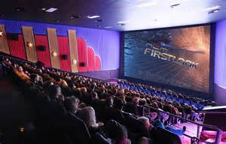
Let’s share!
Do you like watching movies?
Where do you watch movies?
What kinds of qualities(品质) are important in a movie theater?
In a movie theater/cinema.
戏院;剧场

Slide 11
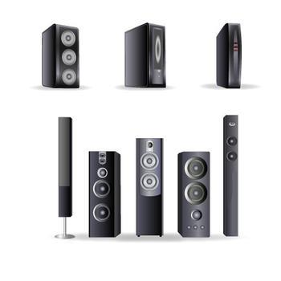
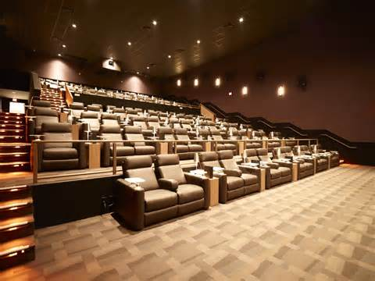
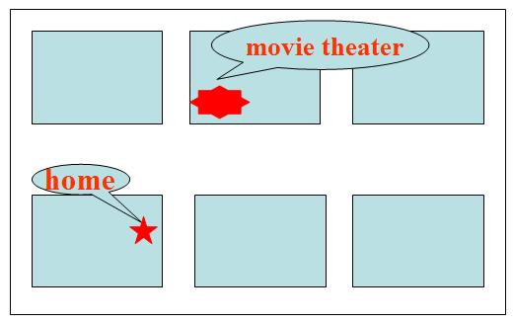
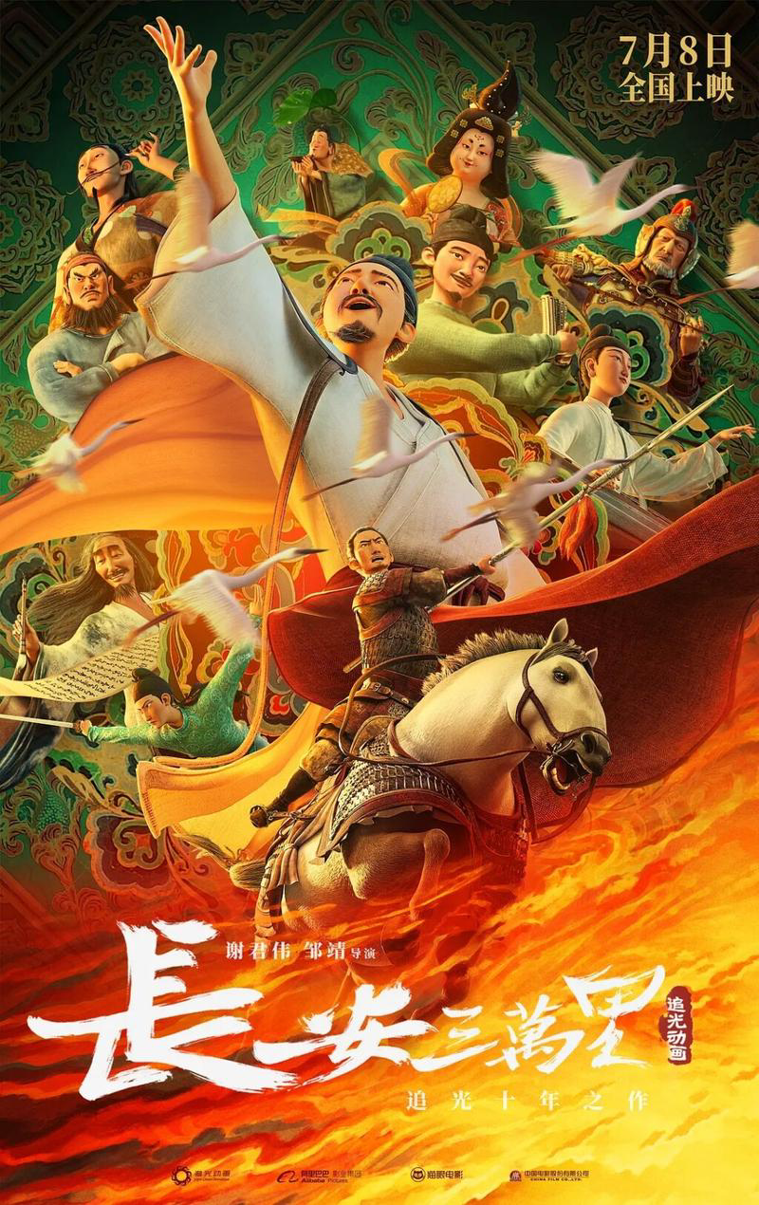
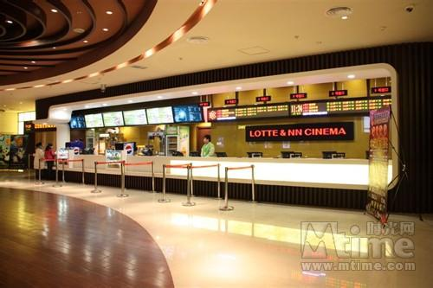
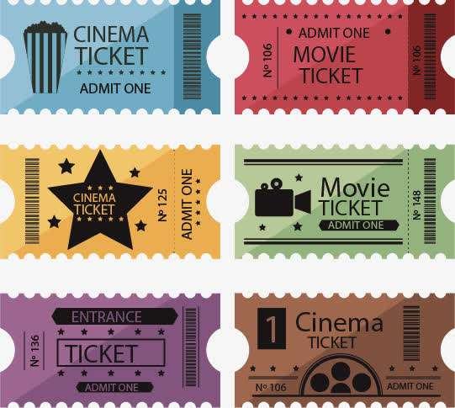
What’s the best movie theater to go to?
A good movie theater should have/be...
big screens
best sound
comfortable seats
￥25
People can buy tickets
quickly/cheaply.
close to home
new/popular movies

Slide 12

How do you choose which movie theater to go to? Write the things in the box under “Important” or “Not Important”.
e.g. For me, the best sound and new movies are important in a movie theater.
comfortable seats big screens buy tickets cheaply best sound new movies be popular be close to home buy tickets quickly
Important | Not Important

Slide 13
Summary
If we want to choose a best movie theater, we should think about：
quality(品质)
price(价格)
service(服务)
distance(距离)
In the same way, when we choose a best store or a best restaurant, we can also compare(对比)these.
【comfortable seats, big screens, best sound,
new and popular movies】
【buy tickets cheaply】
【buy tickets quickly】
【be close to home】

Slide 14


Let’s listen!
Listen and match the statements(叙述) with the movie theaters.
Town Cinema Screen City Movie World
Qualities | Movie theaters
It has the biggest screens.
It’s the most popular near here.
It’s the closest to home. | Town Cinema
It has the shortest waiting time.
It has the best sound.
It has the most comfortable seats.
Movie World
Screen City
Town Cinema
Screen City
Movie World

Slide 15
Listen again.
Conversation 1
Jack: Hi, Anna. Do you want to go to the movies?
Anna: Hi, Jack. Yes, let’s see a movie.
Jack: What’s the best movie theater to go to?
Anna: Town Cinema. It’s the closest to home.
Jack: Yes, but what about the long waiting time to get movie tickets?
Anna: Don’t worry. There are a lot of people working there. You can buy tickets the most quickly at Town Cinema.

Slide 16
Conversation 2
Ken: Hi, Julie.
Julie: Hi, Ken. How are you?
Ken: Good, thanks. Do you want to watch a movie?
Julie: Sure.
Ken: Is there a good movie theater near here?
Julie: Yes, Screen City. It’s the most popular one near here and it has the best sound.
Ken: Sounds good. Let’s go.

Slide 17
Conversation 3
Barry: Hi, Jill. Do you want to see a movie?
Jill: Hi, Barry. Yes, a great idea.
Barry: Do you know a good movie theater?
Jill: Yes, there’s one not far from here.
Barry: What’s it called?
Jill: It’s called Movie World. It has the biggest screens and the most comfortable seats.

Slide 18

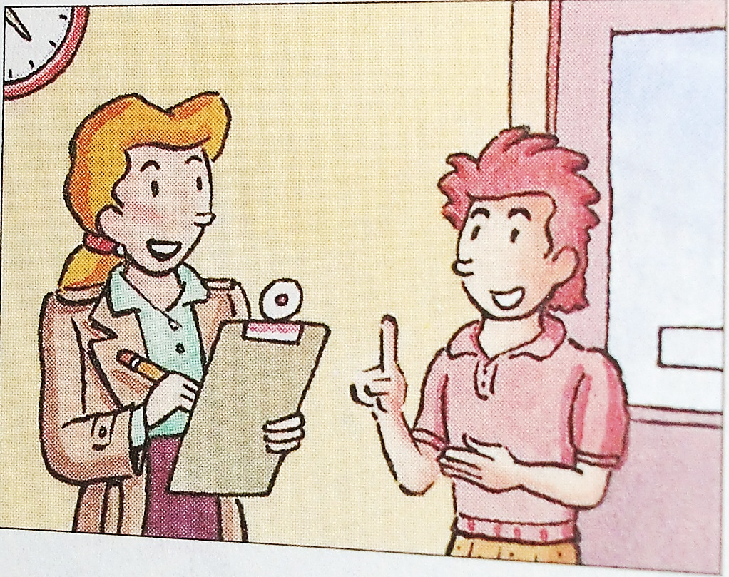
Let’s listen!
Look at the picture. A reporter is interviewing a boy about the best clothes store and the best radio station in Green City.

Slide 19

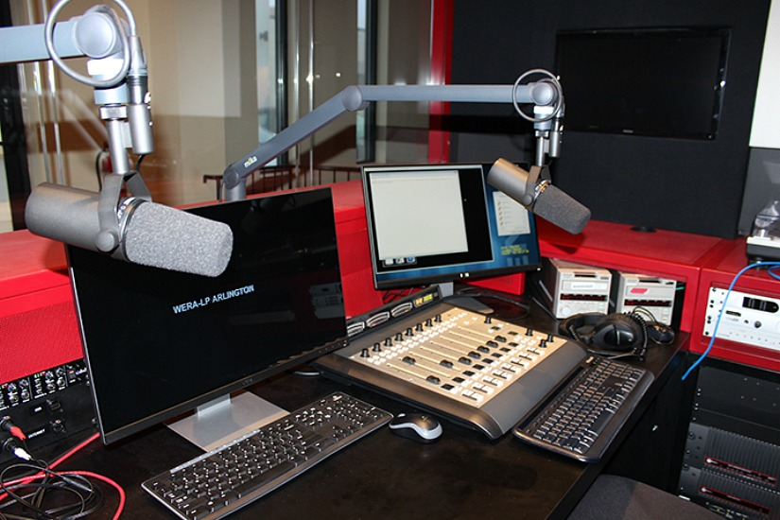
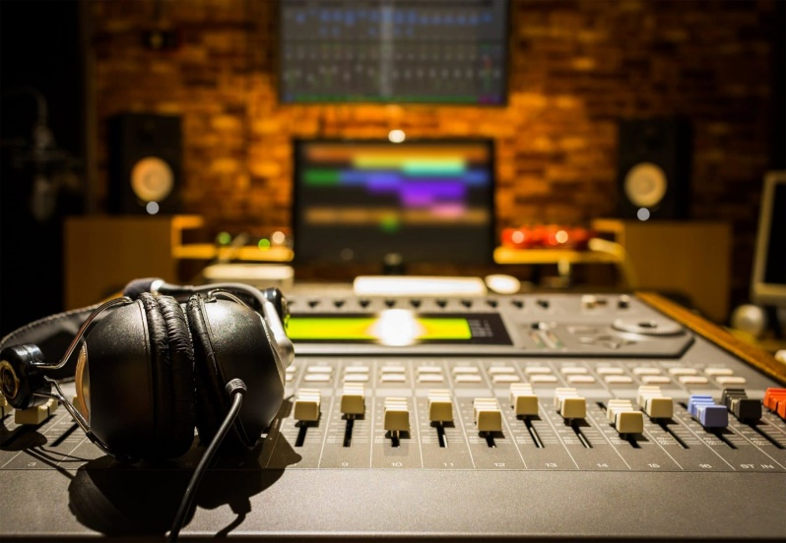
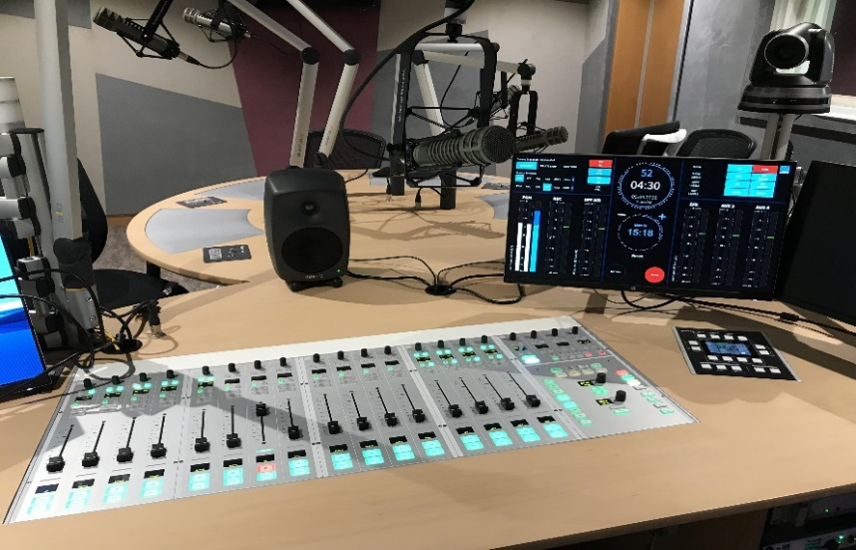
Listen to their conversation. Circle the boy’s answers.
Green City Survey
Which is the best clothes store?
a. Miller’s b. Blue Moon c. Dream Clothes
2. Which is the best radio station?
a. 970 AM b. 97.9 FM c. 107.9 FM

Slide 20

Listen again. Write the correct store or radio station next to each statement.
_____________ It’s the most expensive.
_____________ It has the best clothes.
_____________ It’s the worst store.
_____________ You can buy clothes the most cheaply there.
Blue Moon
Clothes stores
Miller’s
Miller’s
Blue Moon
Dream Clothes
Dream Clothes
Miller’s
Radio Stations
_________ It has the worst music.
_________ They play the most boring songs.
_________ The DJs choose songs the most carefully.
_________ It’s the most popular.
970 AM
97.9 FM
107.9 FM
970 AM
97.9 FM
107.9 FM
97.9 FM

Slide 21
Read the conversations.
Reporter: What’s the best clothes store in Green City?
Boy: Miller’s is the best. It has the best clothes and you can buy clothes the most cheaply there.
Reporter: What do you think about the other stores?
Boy: Well, Blue Moon is in a fun part of town, but it’s the most expensive. And Dream Clothes is worse than Blue Moon. It has the worst service in town. It’s the worst store.

Slide 22
Reporter: OK. What about radio stations?
Boy: 107.9 FM is the best. The DJs choose songs the most carefully. They always play the most interesting music.
Reporter: What about the other radio stations?
Boy: Well, I think 970 AM is pretty bad. It has the worst music.
Reporter: I heard that 97.9 FM is the most popular.
Boy: Yes, it is, but I think they play the most boring songs.
adv. 相当; 十分; 很

Slide 23

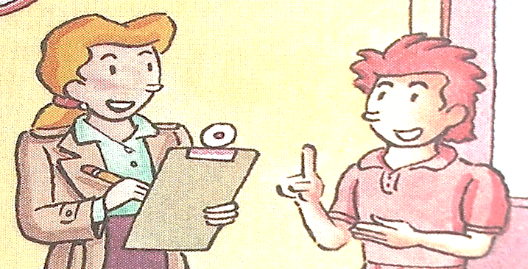
Student A, you are the reporter. Student B, you are the boy. Role-play a conversation using the information in 2a and 2b.
Hello! I’m a reporter. Can I ask you some questions?
Sure.
What’s the best clothes store in town?
I think Miller’s is the best.
Well, Miller’s has …
Why do you think so?

Slide 24
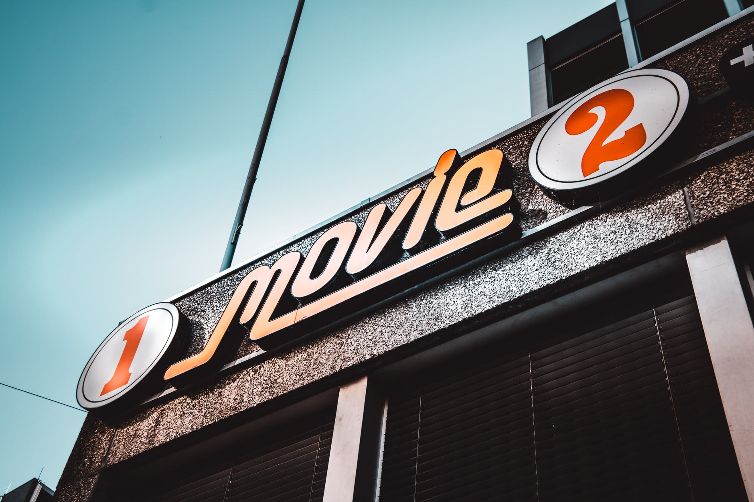


Slide 25





Practice the conversation. Then talk about the movie theaters you know.
What’s the best movie theater?
Sun Cinema. It’s the cheapest.
But I think Moon Theater has the most comfortable seats.

Slide 26

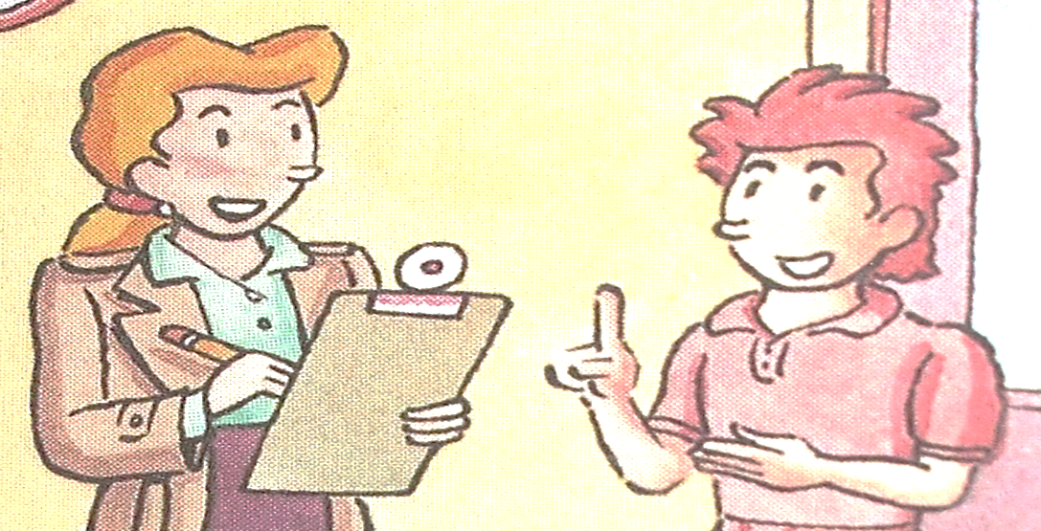
Student A, you are the reporter. Student B, you are the boy. Role-play a conversation using the information in 2a and 2b.
Hello! I’m a reporter. Can I ask you some questions?
Sure.

Slide 27

舒适的座位
大屏幕
离家近
等待时间最短
在城里
欢迎来到……
到目前为止；迄今为止
comfortable seats
big screens
close to home
the shortest waiting time
in town
welcome to ...
so far

Slide 28
句型
—What’s the best movie theater?
—Sun Cinema. It’s the cheapest. But I think Moon Theater has the most comfortable seats.
—Thanks for telling me.

Slide 29
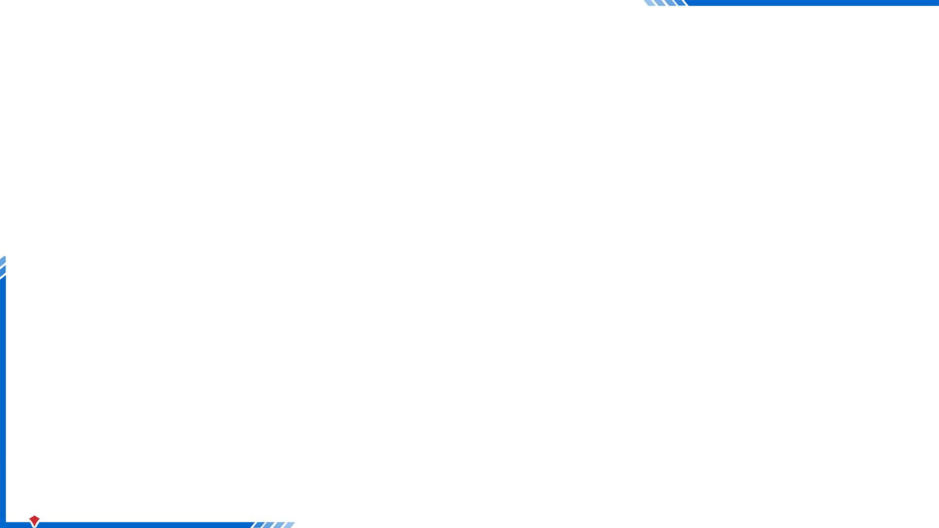

I. 根据句意选择恰当的单词填空，有的需要变换形式。
choose, song, badly, reporter, carefully, fresh
songs
1. Miss Green taught us some English _______ in class.
2. Linda _______ a pair of shoes in this shop yesterday.
3. Alex and Tom are _________ and they work for a newspaper in our city.
4. Of the three supermarkets, you can buy the _______ vegetables and fruit in Full Supermarket.
5. Peter felt sorry because he did the _______ in the basketball game.
6. My mother drives as ________ as my father.
chose
reporters
freshest
worst
carefully

Slide 30
Ⅱ. 根据句意及所给汉语提示，写出所缺内容，每空一词。
1. Xinhua Theater is _______ _______ _______ _______(离我家更近) than Xinmin Theater.
2. I think Lily's Shop is the best shop on Center Street. It sells clothes _______ _______ _______(最便宜地).
3. Dad _______ _______ _______(买了两张票) for the Disneyland.
4. I like taking high-speed trains because they have __________ _______(舒适的座位).
5. _______ _______(到目前为止), what do you think of your school life?
6. Our new house is _______ _______ _______ _______ _______ (离一个公交车站近).
closer to my home
the most cheaply
bought two tickets
comfortable
seats
So far
close to a bus station
next to a bus station

Slide 31


To learn to make comparisons and discuss preferences.
To listen for specific information.
To learn some new words and useful sentence patterns.

Slide 32
Words
comfortable, comfortably, seat, screen, close, carefully, theater, ticket, worst, cheaply, song, choose, reporter, fresh
Phrases
close to, near / around here, so far
Patterns
--What’s the best movie theater?
--Sun Cinema. It’s the cheapest. But I think Moon Theater
has the most comfortable seats.
Welcome to the neighborhood!
Thanks for telling me.

Slide 33
comfortable seats
best sound
buy tickets quickly
big screens

Slide 34
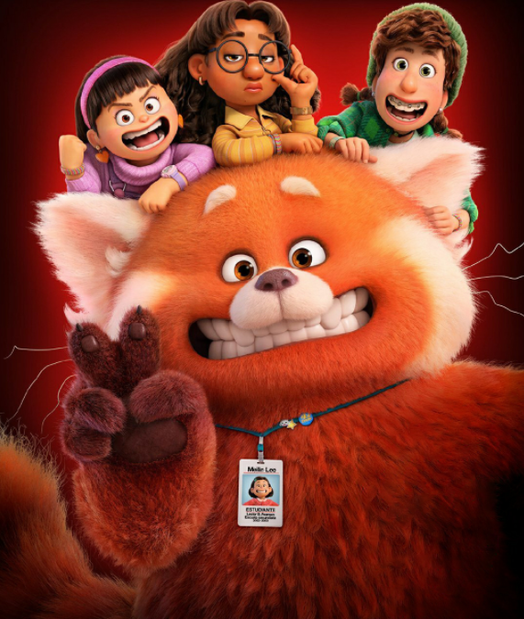
close to home
new or popular movies

Slide 35
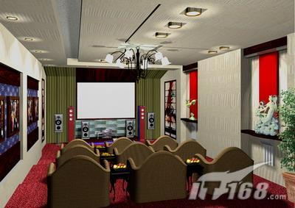
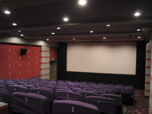
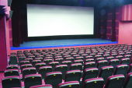
Here is some information about three movie theaters.
Wanda Cinema
has a big screen.
Bona Cinema
has a bigger screen.
Poly Cinema
has the biggest screen.

Slide 36
Poly Cinema
￥35
Tickets are cheap.
Bona Cinema
￥30
Tickets are cheaper.
Wanda Cinema
￥25
Tickets are the cheapest.

Slide 37
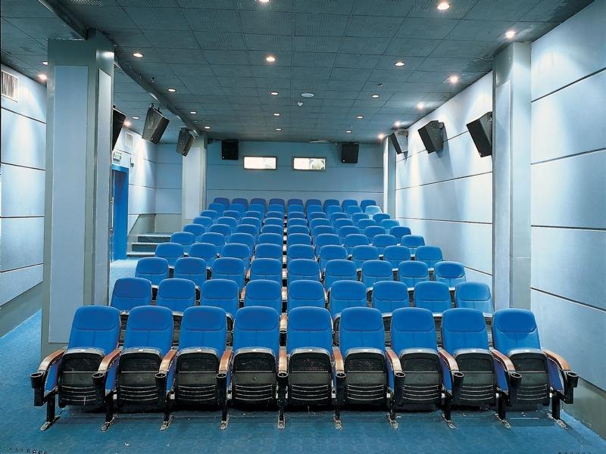
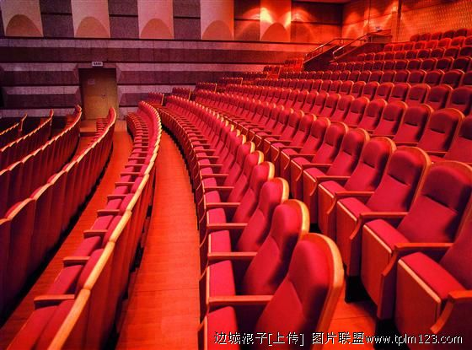
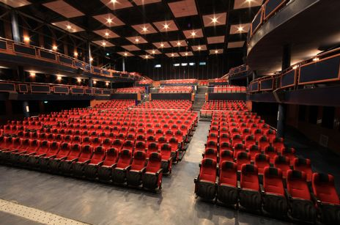
Wanda Cinema
has comfortable seats.
Poly Cinema
has more comfortable seats.
Bona Cinema
has the most comfortable seats.

Slide 38


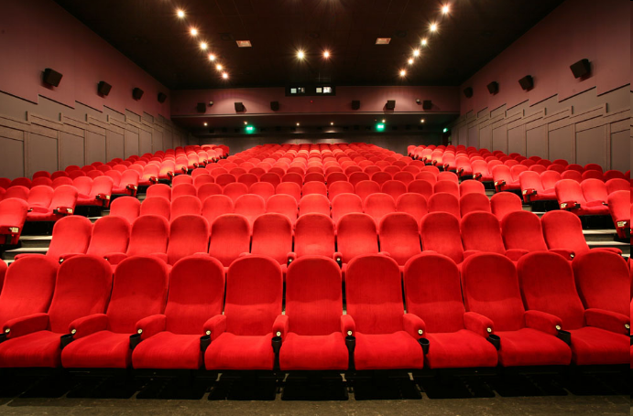
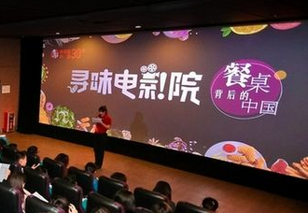

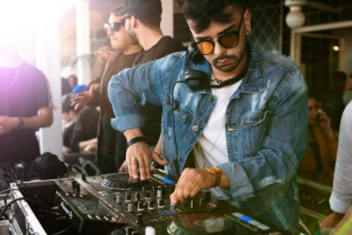
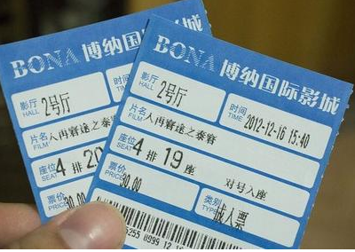
seat n. 座位
screen n. 屏幕
theater n. 剧场
ticket n. 票
DJ n. 电台主持人
reporter n. 记者

Slide 39
worst adj. & adv. (bad和badly的最高级)
最差(的); 最坏(的); 最糟(的)
e.g. This is the worst storm for five years. (adj.) 这是五年来最厉害的暴风雨。
Linda sings worst of the three girls. (adv.)
三个女孩中， Linda唱得最差。

Slide 40
cheaply adv. 便宜地
carefully adv. 细致地; 小心地; 谨慎地
comfortably adv. 舒服地; 舒适地
构词法：形容词+-ly →副词
e.g. You can buy skirts cheaply in this clothes store.
在这家服装店里你可以很便宜地买到短裙。
Alice chooses clothes carefully.
Alice挑衣服很仔细。

Slide 41
Listen again. Write the correct store or radio station next to each statement.
Clothes stores
Miller’s
Blue Moon Dream Clothes
_____________ It’s the most expensive.
_____________ It has the best clothes.
_____________ It’s the worst store.
_____________ You can buy clothes the most cheaply there.
Blue Moon
Miller’s
Dream Clothes
Miller’s

Slide 42
Radio Stations
_________ It has the worst music.
_________ They play the most boring songs.
_________ The DJs choose songs the most carefully.
_________ It’s the most popular.
970 AM 97.9 FM 107.9 FM
970 AM
97.9 FM
107.9 FM
97.9 FM

Slide 43


Recite the conversation of 2d.
Preview the Grammar Focus.
Make two conversations.
Example:
—What’s the best movie theater?
—Sun Cinema. It’s the cheapest.
—But I think Moon Theater has the most comfortable seats.

